Slide 1
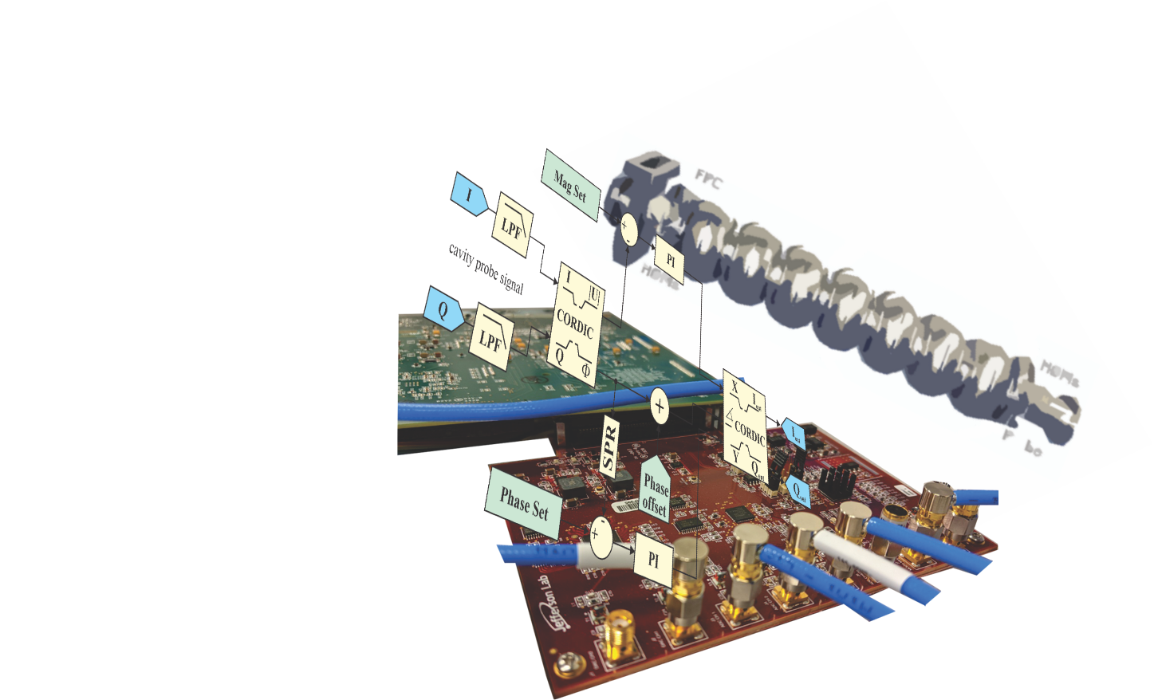
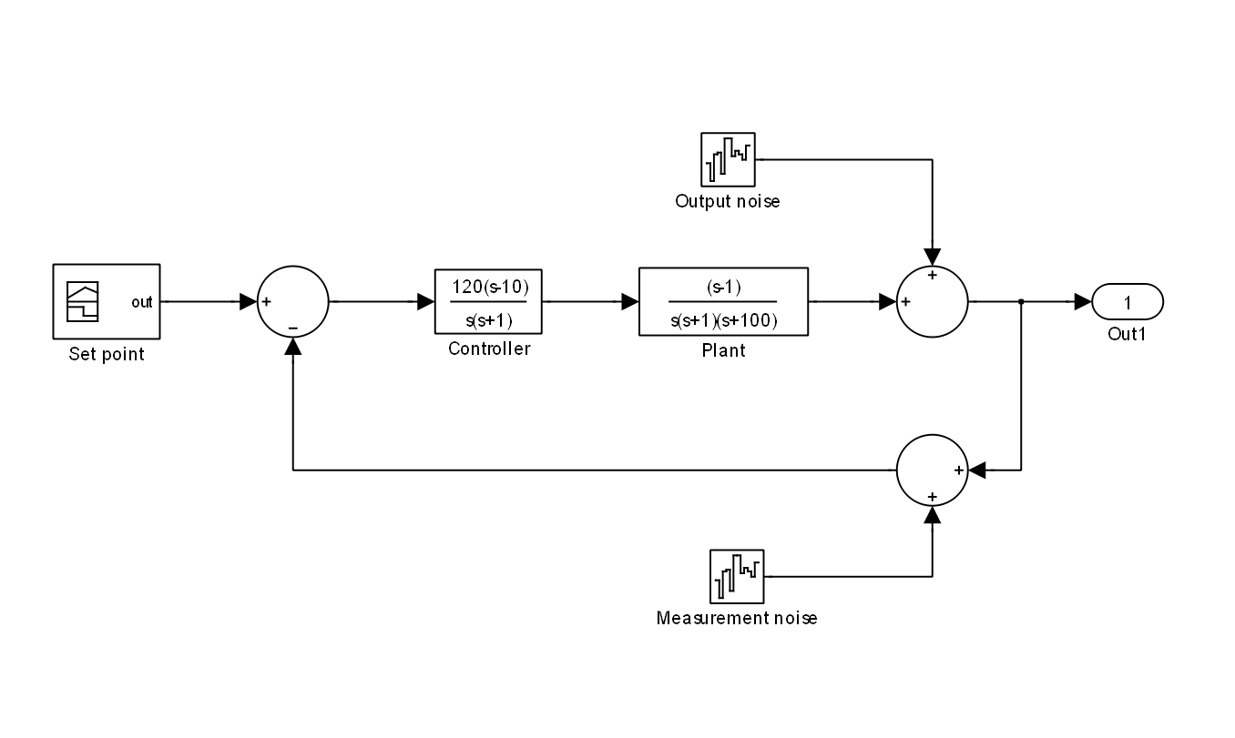

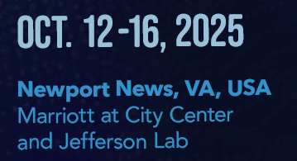
LLRF Activities at Jefferson Lab
Tomasz Plawski
for the JLAB LLRF Team

Slide 2
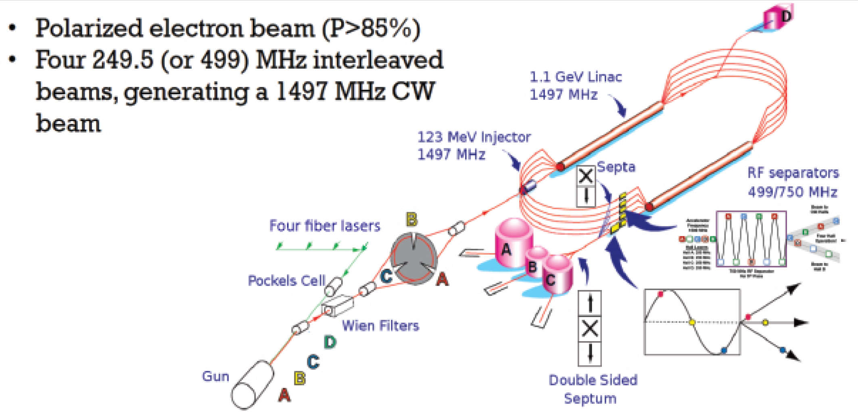
The Continuous Electron Beam Accelerator Facility (CEBAF), located at the Thomas Jefferson National Accelerator Facility (TJNAF), provides high-quality beams of polarized electrons. These beams allow scientists to extract information on the quark and gluon structure of protons and neutrons. Accelerator operates as a pair of superconducting radio frequency (SRF) linacs arranged in a "racetrack" configuration, capable of simultaneously delivering electron beams to four experimental halls

Slide 3
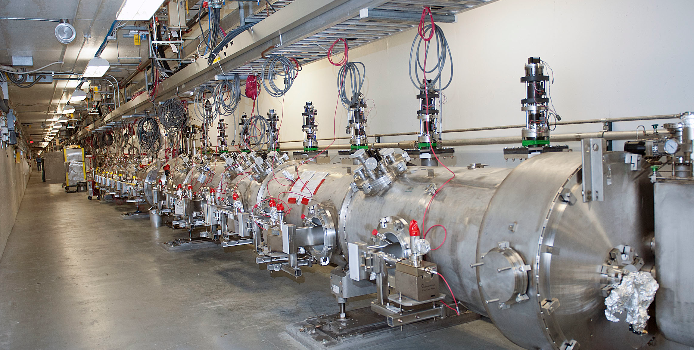
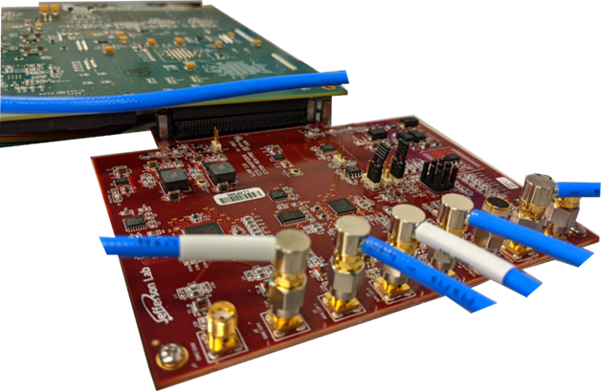
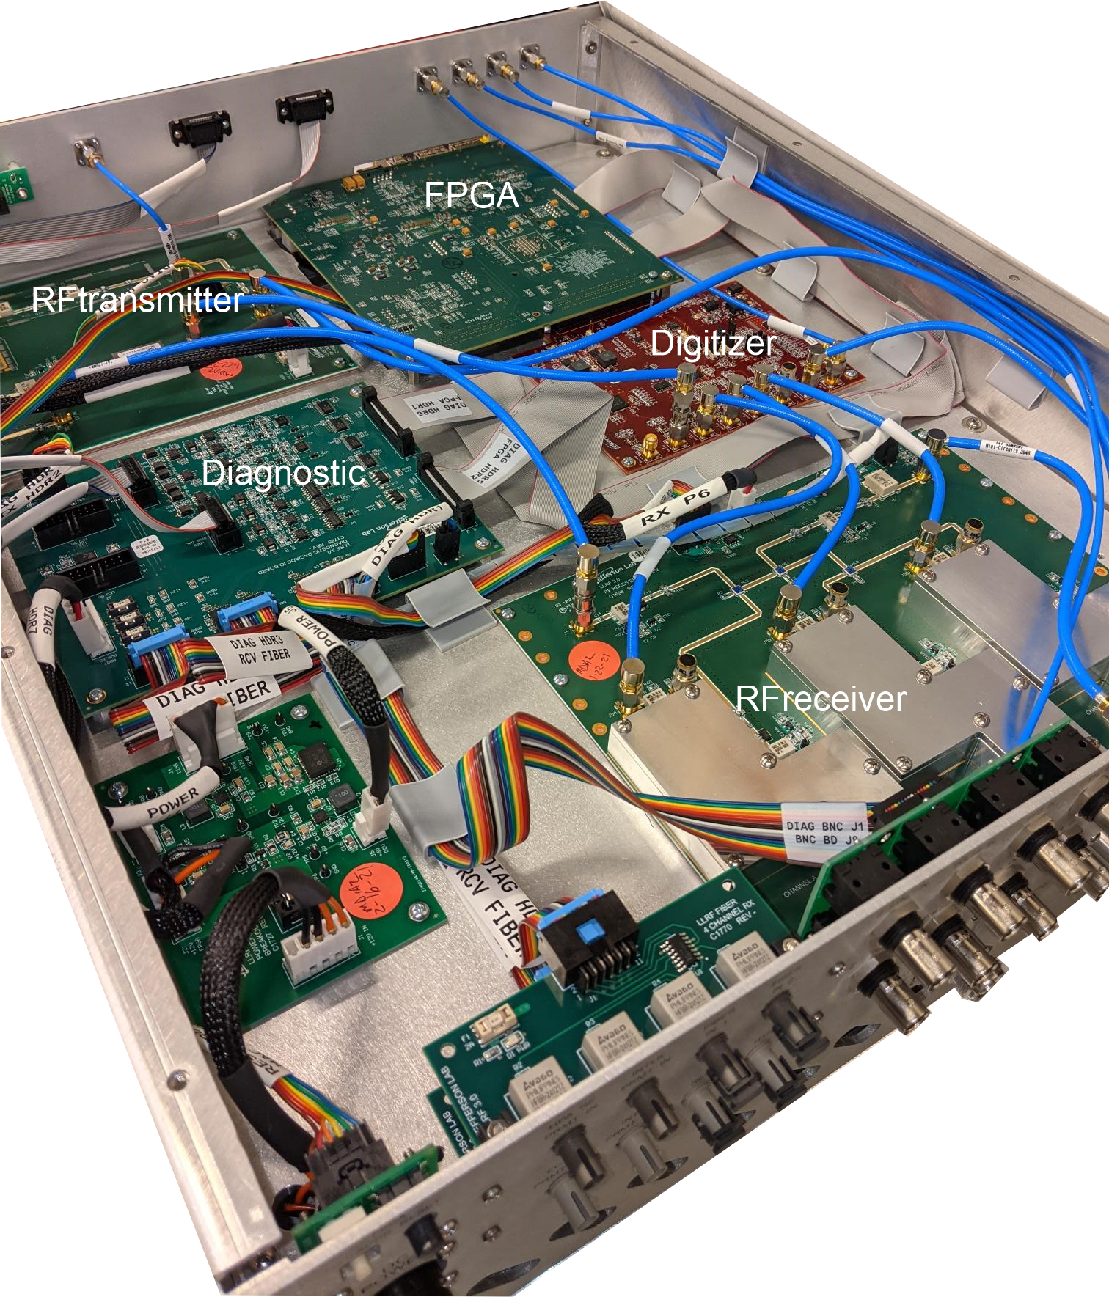
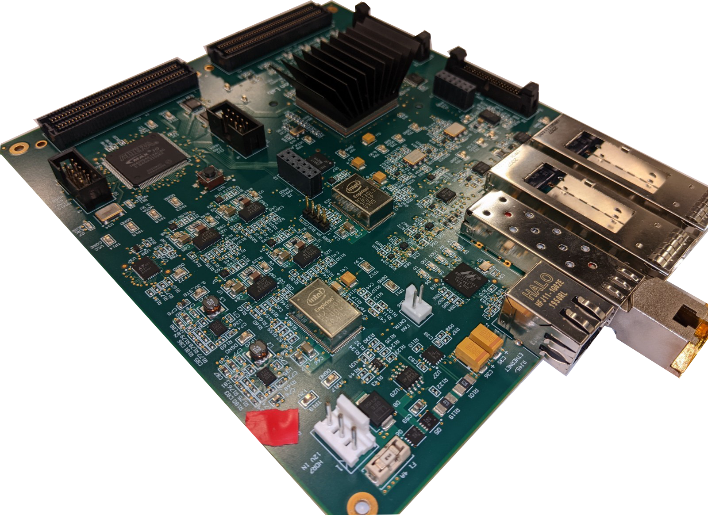
Tasks and Responsibilities for the JLAB LLRF Team
Support the operation of the CEBAF accelerator, which includes:
418 superconducting (SC) cavities in two linacs
20 normal conducting (NC) cavities in the Injector and Separator
LLRF Upgrade – Production, installation, and commissioning of a new generation of LLRF systems in the machine
Field control algorithm – continues improvements
Maintenance of the Master Oscillator/Local Oscillator (MO/LO) Reference Systems and implementation of RF over Fiber (RFoF) technology
Work on data acquisition (DAQ) systems to enhance RF operation and diagnostics
Collaborate on Electron-Ion Collider RF systems (BNL) as part of a partnership between BNL and JLAB
Participate in the PIP II (Fermilab) collaboration, focusing on Resonance Control Systems
Provide support for control systems in specific projects, including the K-Long experiment and the UITF-Nb3Sn experiment

Slide 4
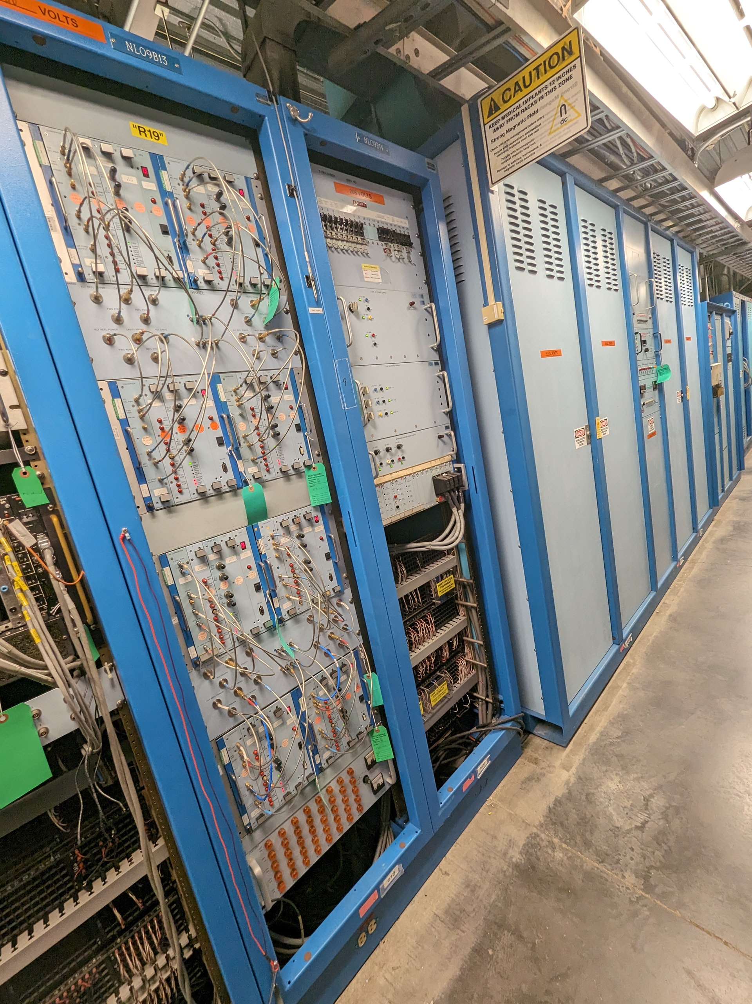
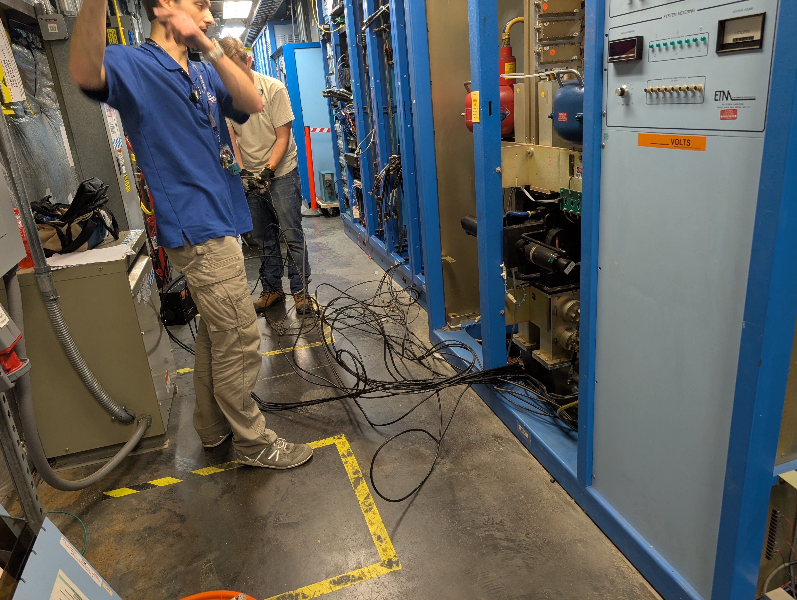
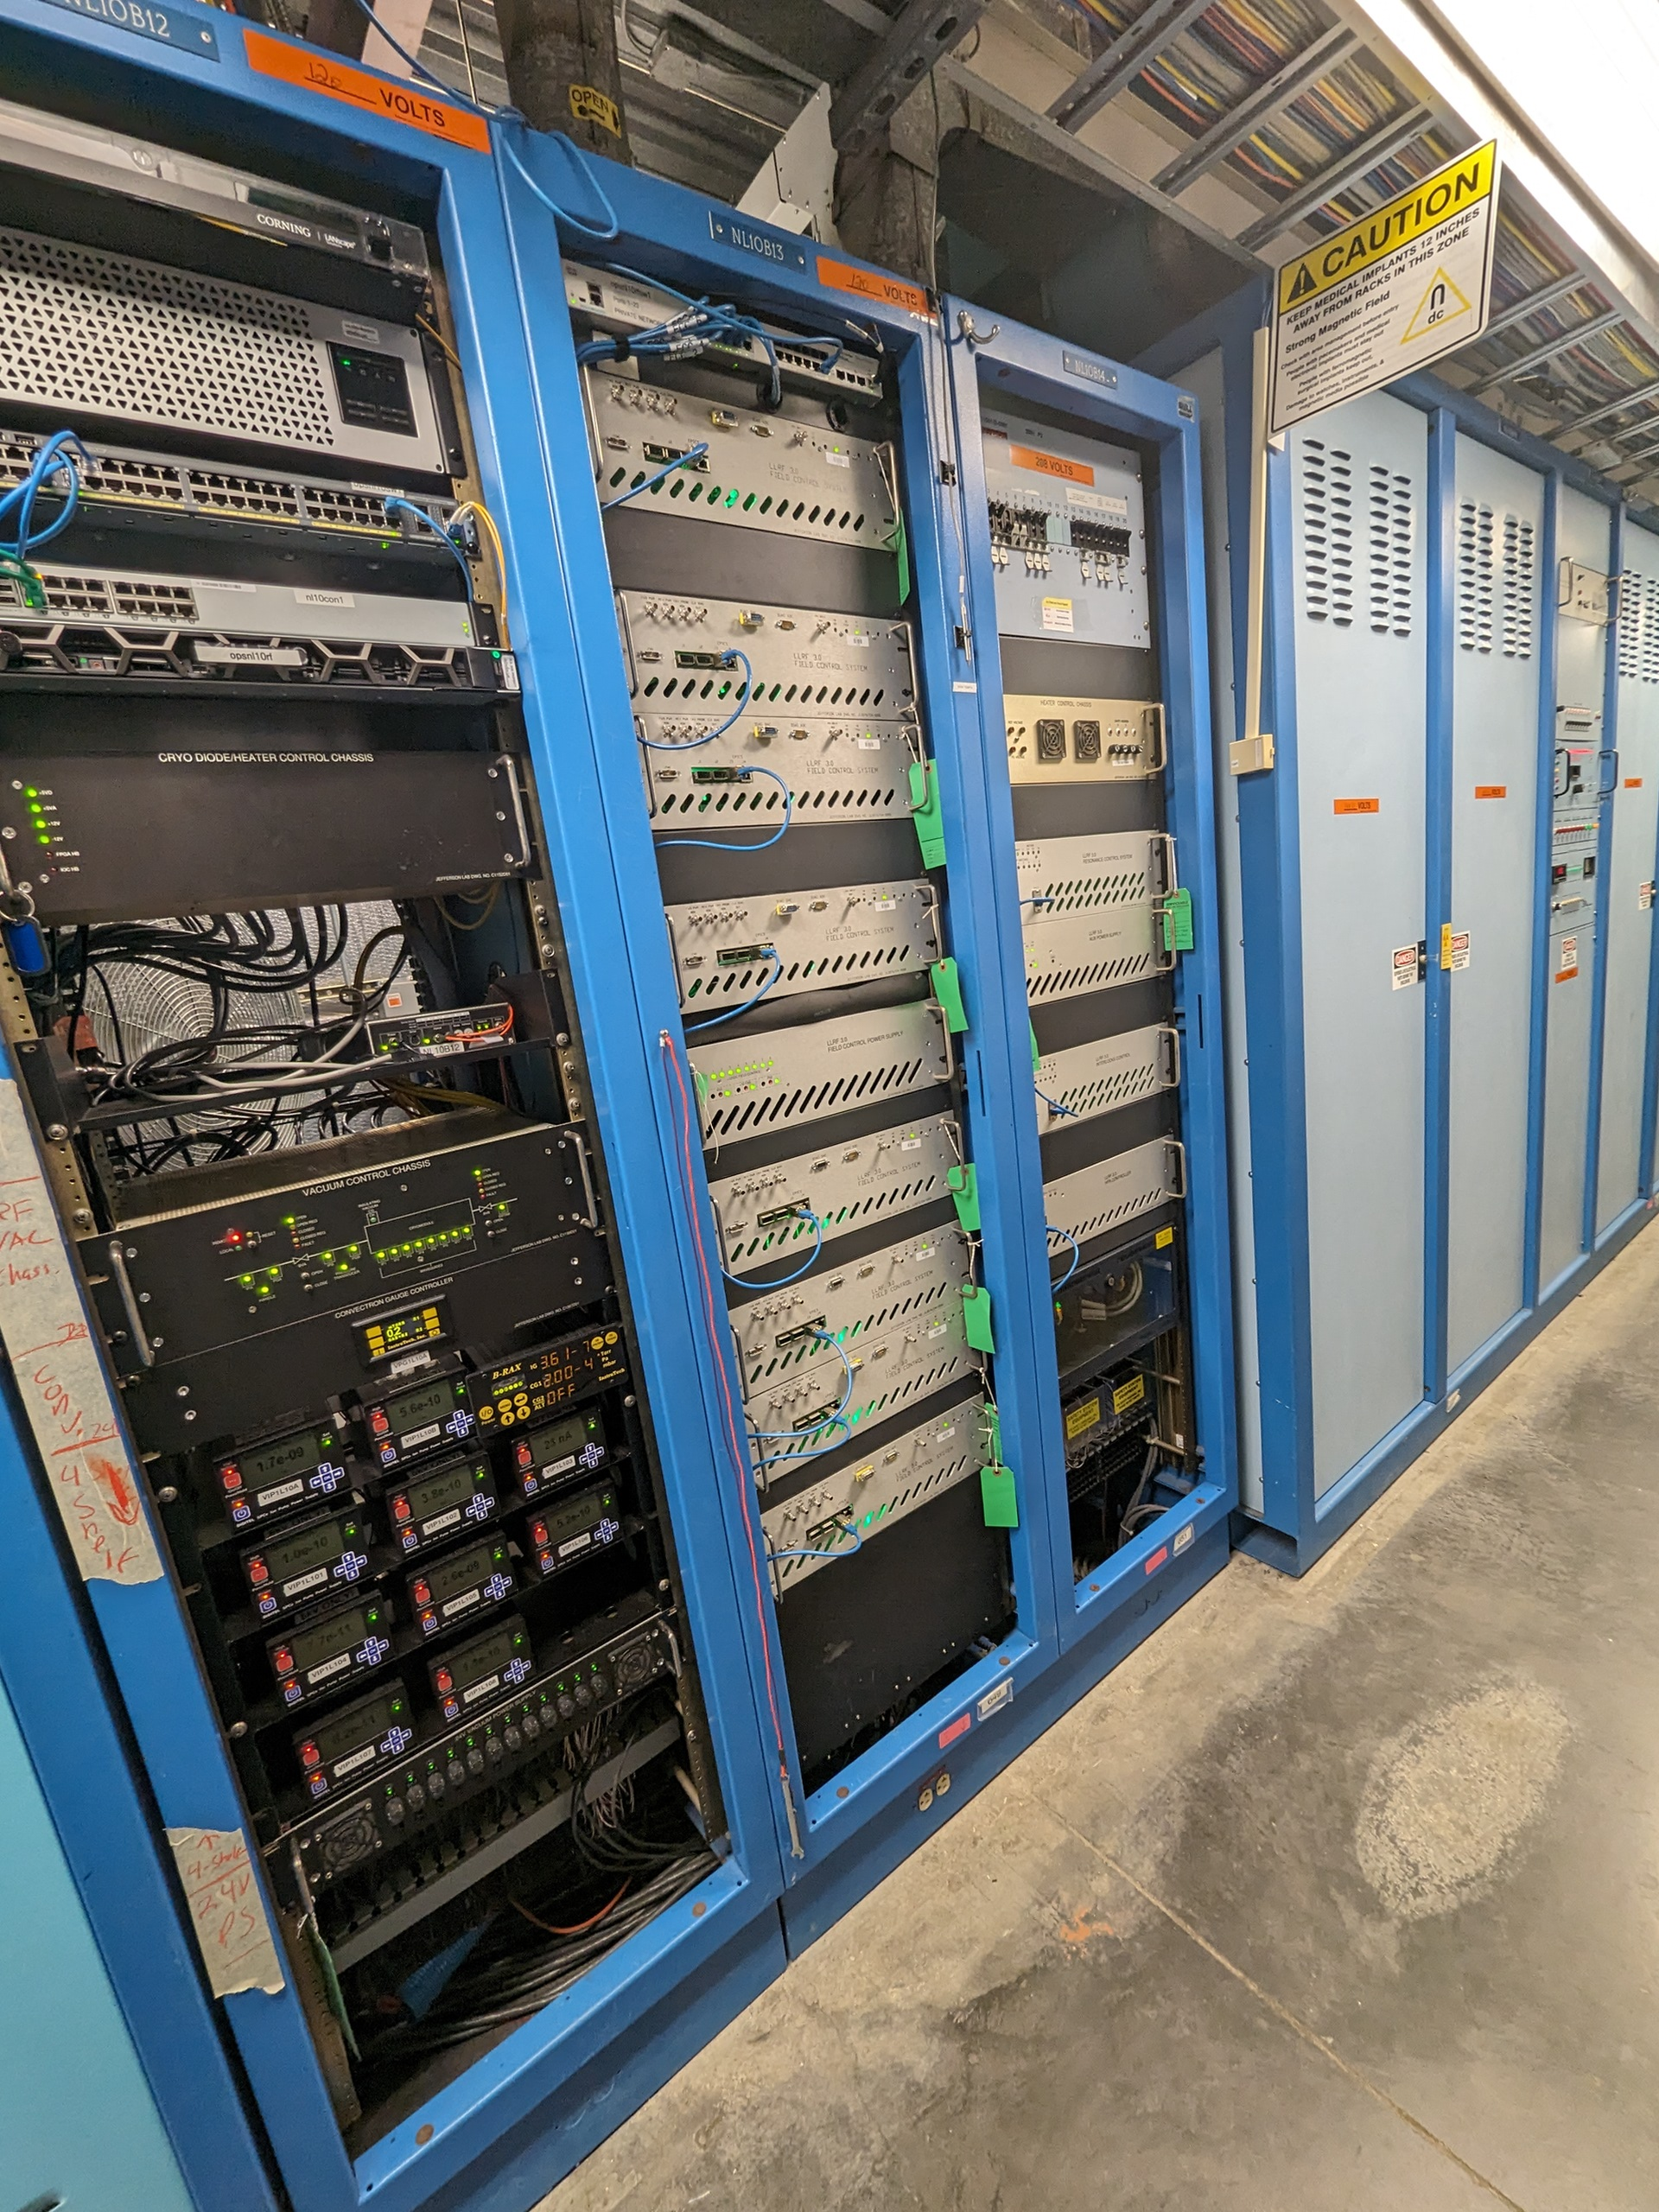
LLRF COMMISSIONING OF THE CEBAF C75 UPGRADES SAM 2024/2025 Poster #79 M. Geesaman, et al.
ABSTRACT
During Jefferson Lab’s Scheduled Accelerator Maintenance (SAM) in 2024, two C75 cryomodules were installed in CEBAF with JLab’s Low Level RF (LLRF) 3.0 digital control system. Three key processes of JLab’s LLRF commissioning include completing Interlock verification, klystron characterization, and cavity characterization. This paper summarizes the preparation, automation and commissioning efforts for the new cryomodule installation and controls checkout.

Slide 5
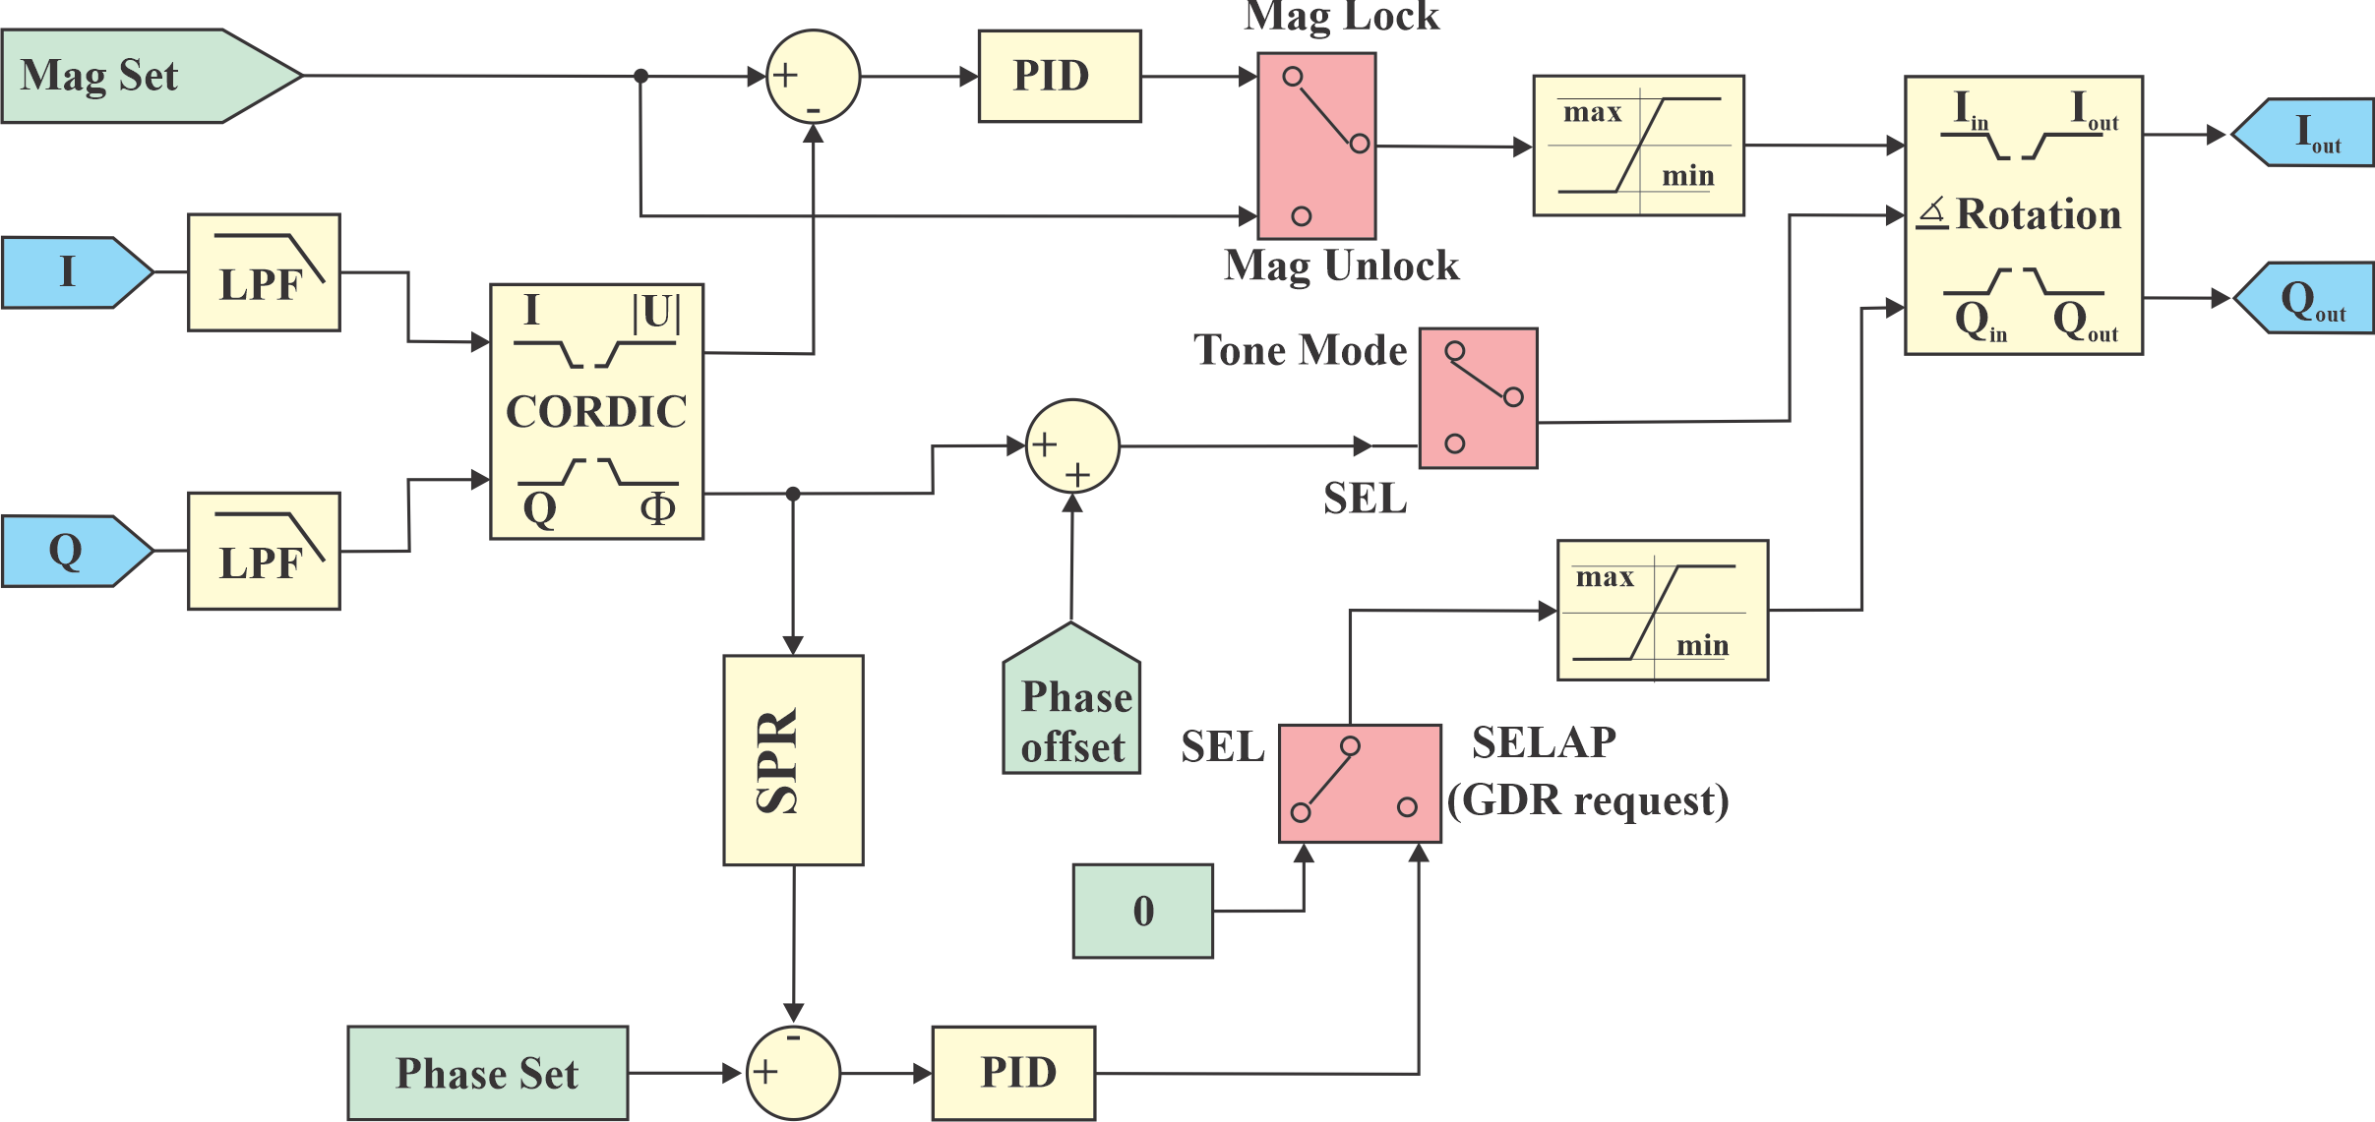
Advancement in LLRF 3.0 SELAP firmware/software development
Exception handling in SELAP (Self-Excited Loop Amplitude and Phase) at JLAB
Rama Bachimanchi
Oct. 16, 2025 at 10:30 am
SELAP (Self-Excited Loop Amplitude and Phase) algorithm has been operational at Jefferson Lab for controlling high-Q cavities since 2021. The core algorithm of controlling the amplitude and the phase works reliably, independent of the environment. When combined with the operational aspects such as high microphonics, mechanical coupling between the cavities, heavy beam loading, etc., a lot of exception handling had to be added in the gateware and software to make the operation easier and reliable. This poster describes some of the operational aspects observed and the methodology used for detection and mitigation.

Slide 6
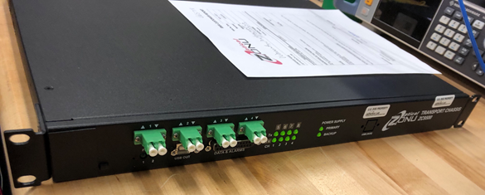
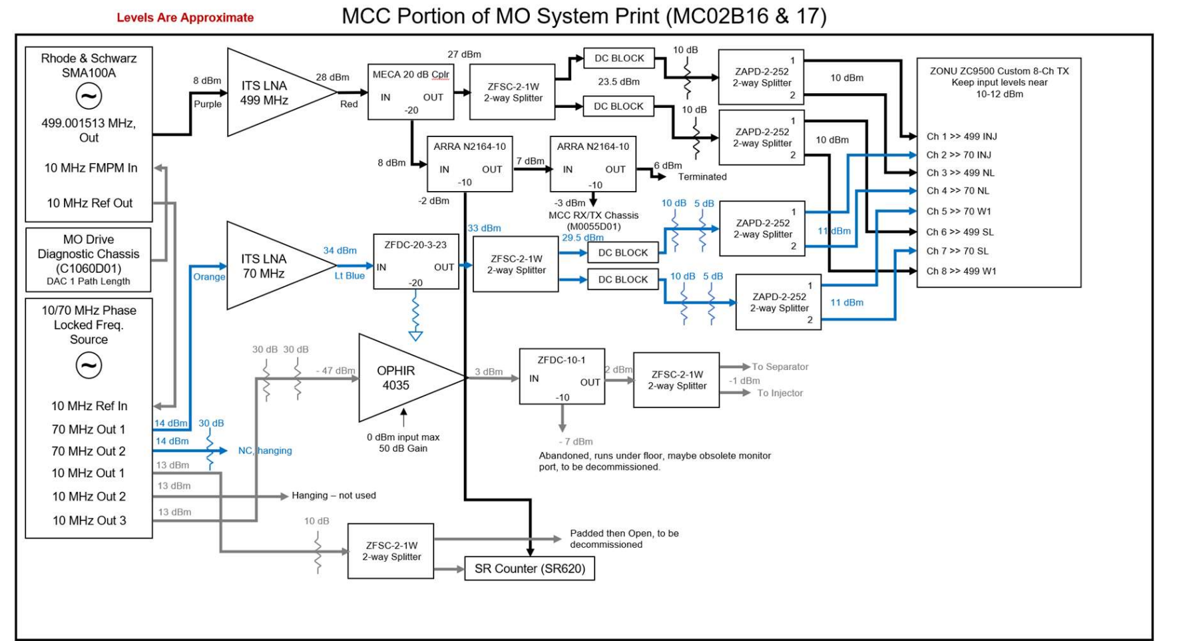
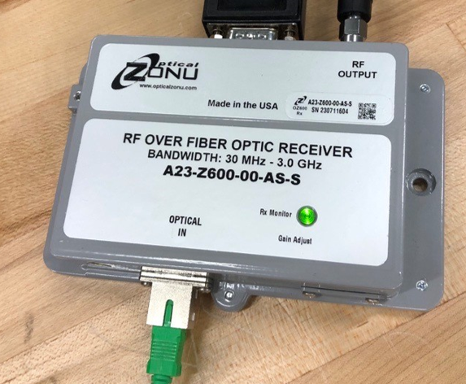
RF Reference System – RF over Fiber (RFoF) Upgrade continues
• Replace aging underground coaxial cables for improved performance.
• Provide better isolation from lightning-induced electromagnetic interference (EMI).
• Ensure easy installation with minimal complications.
• Minimize RF losses over long distances.

Slide 7
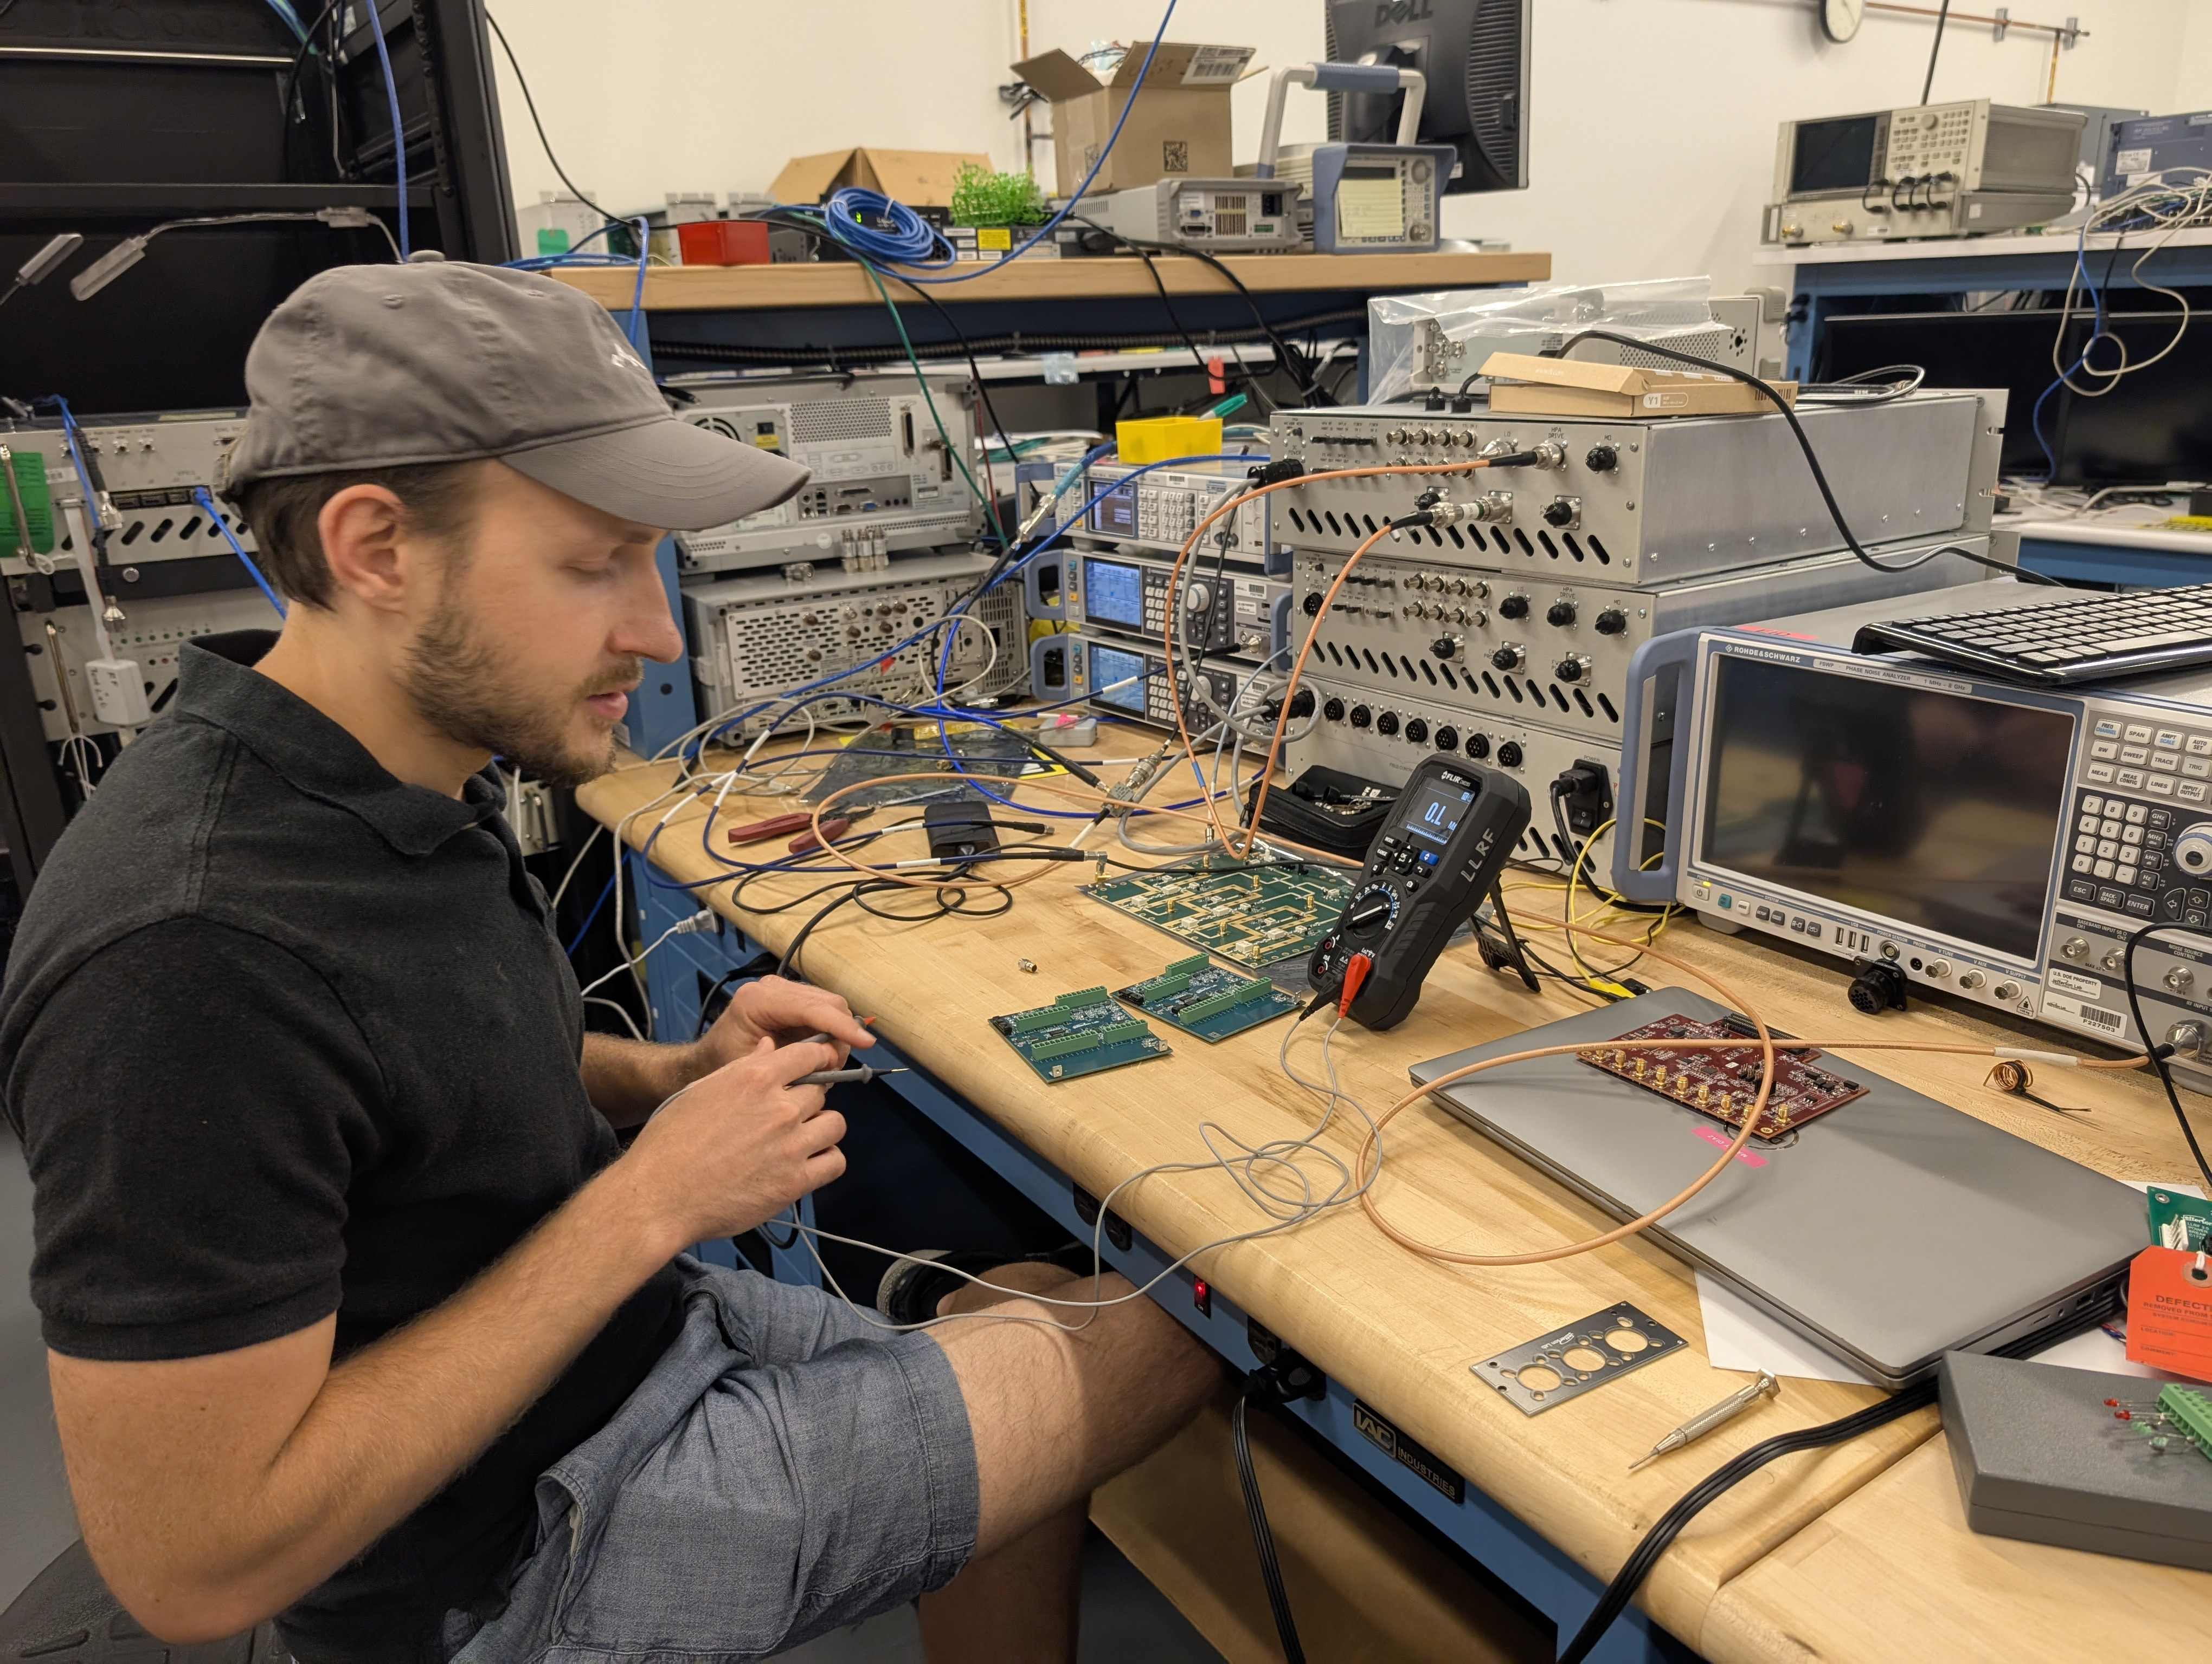
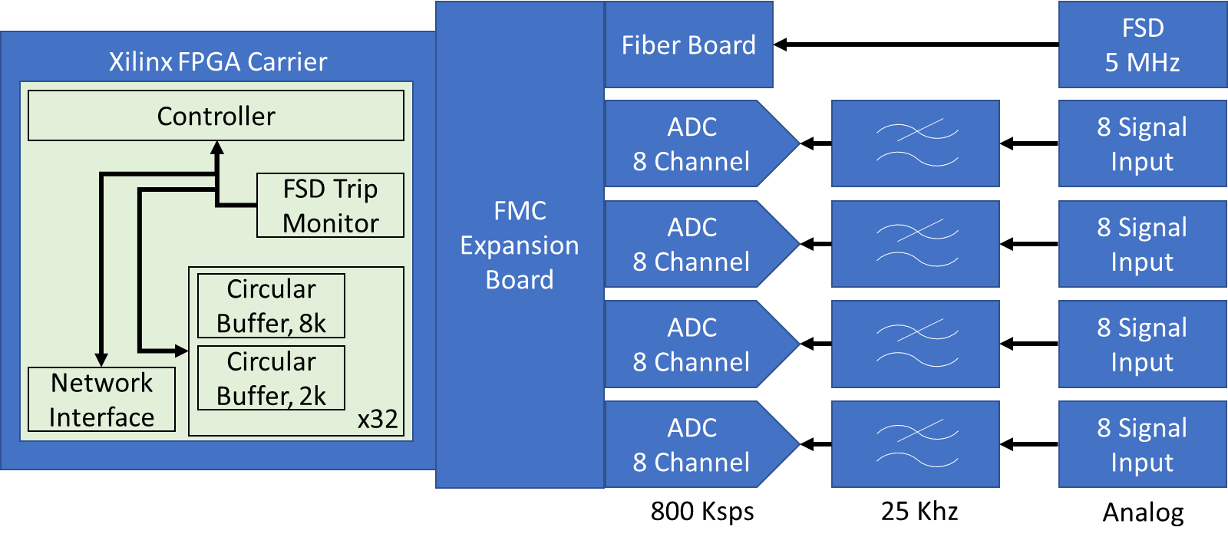
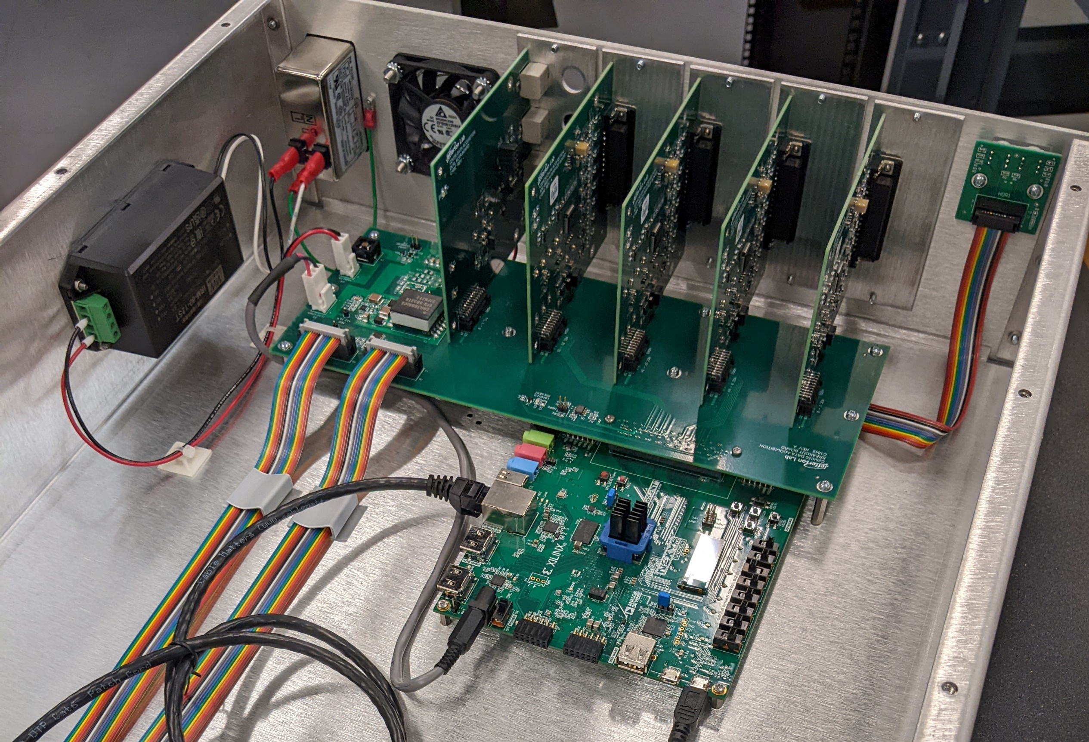
Fast DAQ for Machine Learning
James Latshaw, et al.
Poster #75
The Fast DAQ system was presented at LLRF conference in 2023 as a tool
giving new life to CEBAF’s legacy CAMAC RF Control system [1]. The legacy
CAMAC system, though robust in its initial design, does not provide
control signal information at a fast enough rate to be useful for debugging
transients. The Fast DAQ system that CEBAF’s LLRF team developed
interfaces with control signals form the legacy CAMAC and makes them
available to operators, engineers and technicians over the network. This
poster will lightly review the functionality of the tool (see LLRF 2023
submission for full details) but will have its focus on how this new data
has benefited CEBAF and generated several interesting spinoff projects.

Slide 8
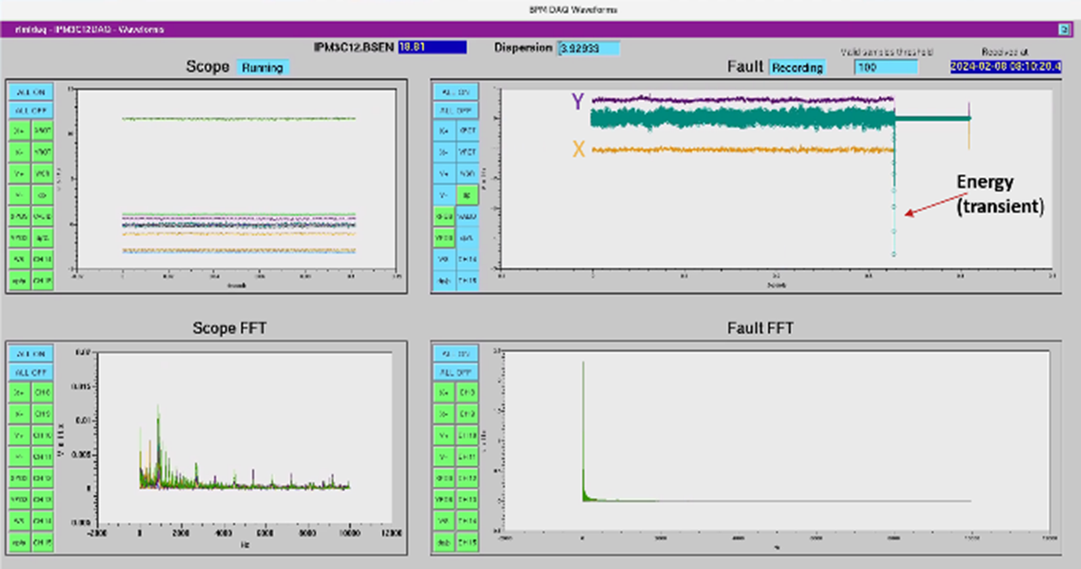
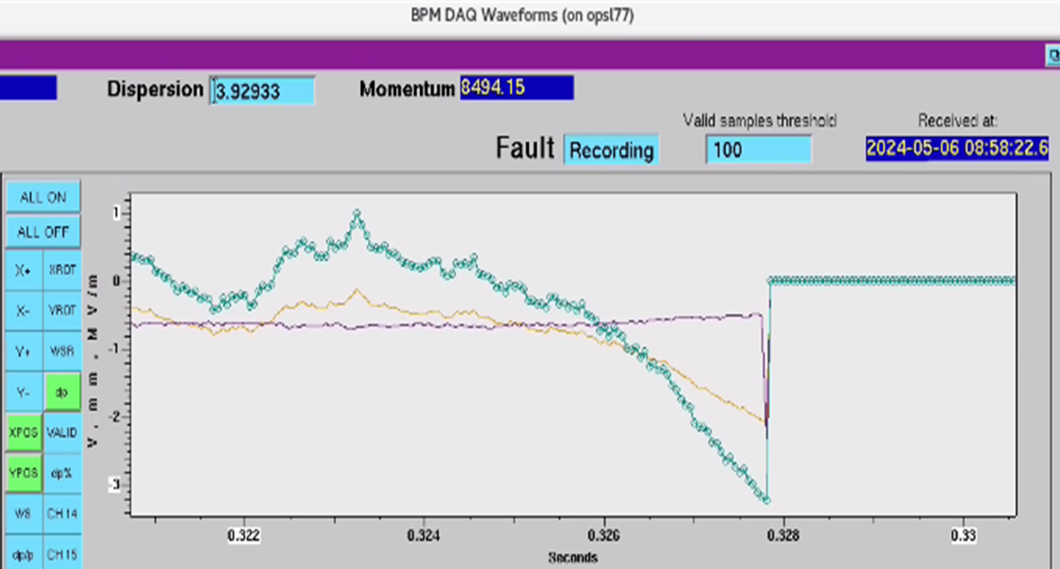
Identifying the source of beam loss events with Fast Data Acquisition (DAQ)
Jayendrika Tiskumara, et al.
Poster #67
Determining whether an RF cavity with an undetected gradient or phase transient is the culprit behind a beam loss event has been found to be a valuable tool for CEBAF operations. Analysis of beam position with the existing switched electrode electronics BPM hardware at the dispersive area and energy variation before a beam loss event was suggested as a method to determine if the beam loss event was correlated with an energy transient.

Slide 9
EIC oral presentation:
Overview of Electron Ion Collider RF Systems, Geetha Narayan
Kevin Mernick, Geetha Narayan,
Low-Level RF System Development for EIC Crab Cavities Freddy Severino, BNL
Electron-Ion Collider RF Systems (BNL) -a collaborative effort between BNL and JLAB
RF Down-converter/ Up-converter - Joshua Settle available for conversation during workshop
LO frequencies generation Local Oscillator Conditioner for the Electron Ion Collider, Joshua Settle and Kevin Mernick , Poster #78
Fast Digitizer - Rama Bachimanchi available for conversation during workshop
Resonance Control & Interlock System James Latshaw, Poster #74

Slide 10
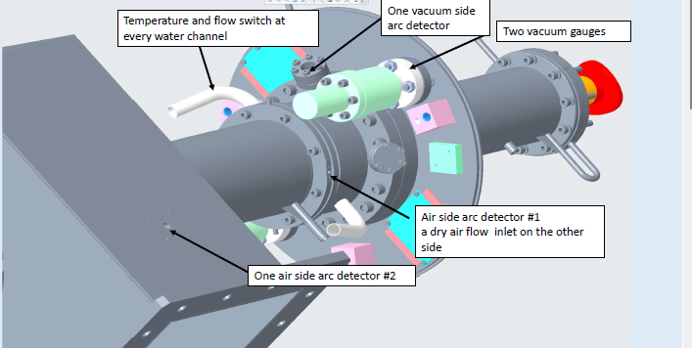
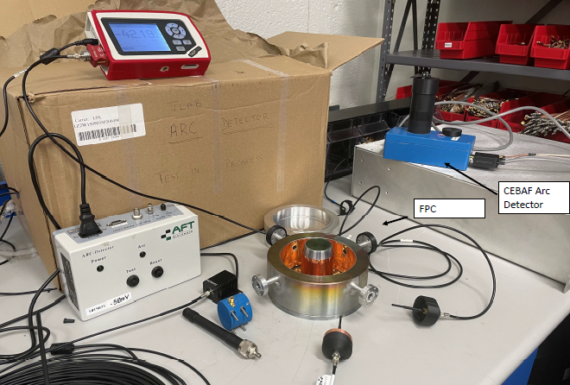
EIC Resonance and Interlocks Control
James Latshaw, et al.
Poster #74
The Resonance and Interlocks Chassis is an important part of any RF control design. When leveraged correctly, it will afford the user the ability to tune a given cavity to machine reference frequency, correct for microphonics or slow drifts, and provide all the necessary safety interlocks which will reduce the risk of equipment being damaged during operations. Furthermore, it will provide signals that can be used to diagnose operational problems and overall system health. With regards to controllability and system protection, it is one of the most important investments that can be made. The EIC project poses a very interesting problem as there are a dozen different types of cavity designs planned, each with its own interlock and resonance control needs.

Slide 11
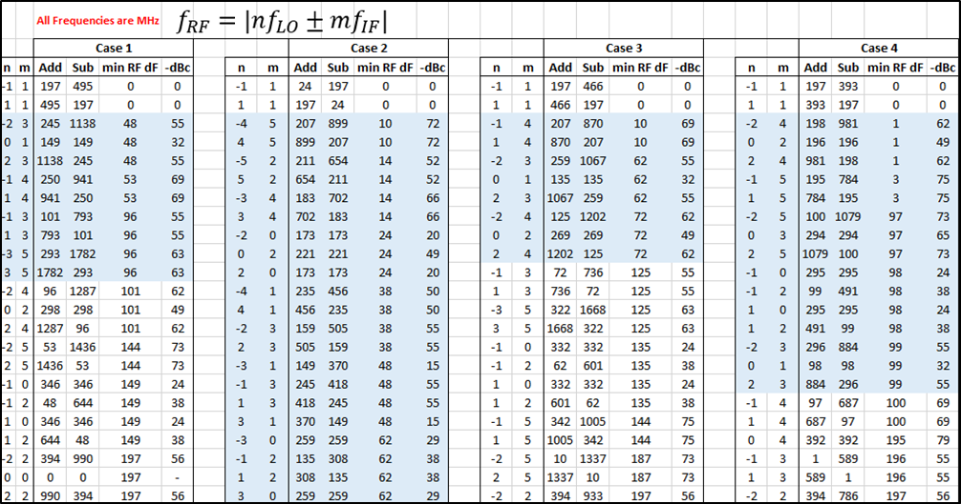
Local Oscillator Conditioner for the Electron Ion Collider
Joshua Settle & Kevin Mernick
Poster #78
…There are multiple frequencies in the VHF and UHF bands which require up and/or down conversion, and designing one circuit board that can accommodate local oscillator (LO) signals for multiple mixing schemes was a valuable and interesting task. A combinatorics problem emerged out of this component’s constraints that required organizing a large number of cases and integrating commercial data to reveal the best design choices…..

Slide 12
Thank you for your attention. JLab LLRF Team
Ramakrishna Bachimanchi
Michael Geesaman
James Latshaw
Tomasz Plawski
Joshua Settle
Jayendrika Tiskumara
*Authored by JSA, LLC under U.S. DOE Contract DE-AC05- 06OR23177 and DE-SC0005264. The U.S. Govt. retains a non-exclusive, paid-up, irrevocable, world-wide license to publish or reproduce this for U.S. Govt. purposes.
† Tomasz Plawski, Jefferson Lab, 600 Kelvin DR STE2, Newport News, VA 23606, USA email: plawski@jlab.org

